Slide 1
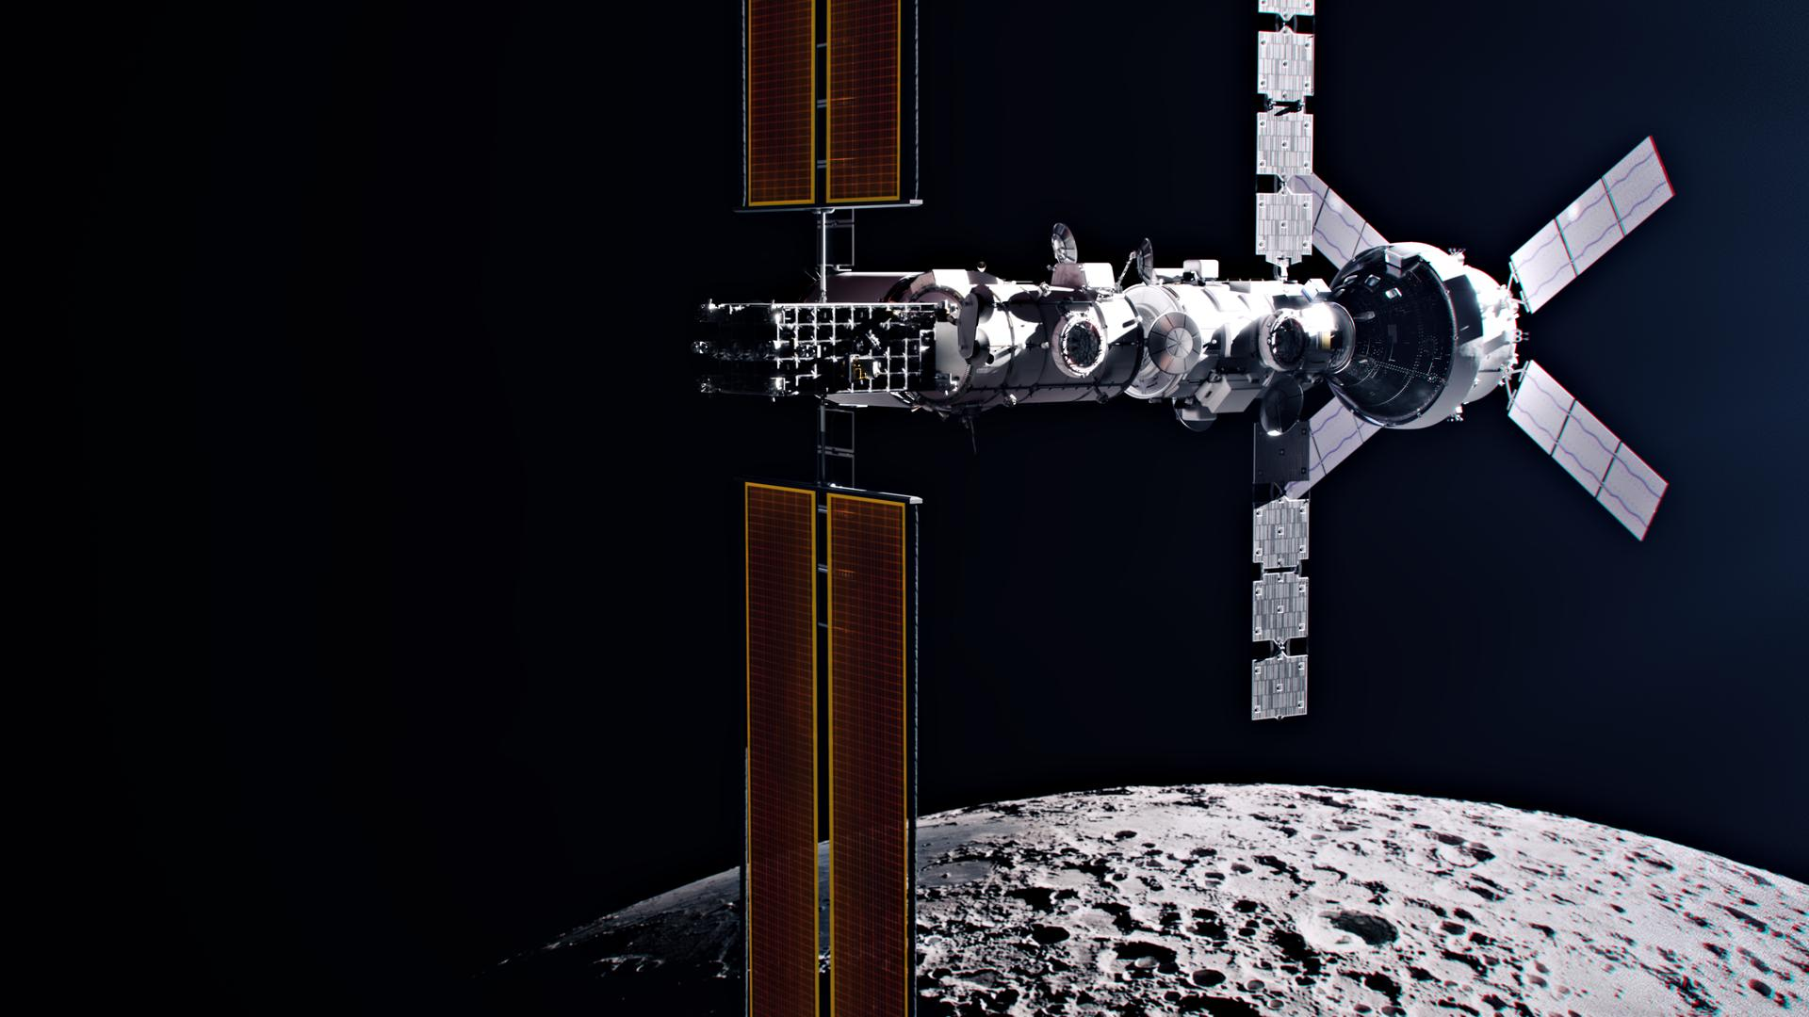
Jakub piwosz
Katie mulvihill
Boundless
Ahmad Elhan
Ngoc Thanh Mai

Slide 2
HELIOS
Vision and Mission
Pioneering a new stage of
commercialization.
A new economical and scientific
breakthrough, sustainably.
Ethos
Problem
Why Us?
Phased
Revenue
Model
Outlook

Slide 3
HELIOS
Problem Statement
LEO prospected for commercialization.
However, there no plans to further industrialize the space.
Ethos
Problem
Why Us?
Phased
Revenue
Model
Outlook

Slide 4
HELIOS
Why Us?
Circular space economy.
Scalable facilities.
Ethos
Problem
Why Us?
Phased
Revenue
Model
Outlook

Slide 5
HELIOS
Phased Revenue Model
HELIOS space station is a phased venture. 3 main phases initializes each new milestone Boundless has set to achieve the goal of a commercial low-earth orbit.
Ethos
Problem
Why Us?
Phased
Revenue
Model
Outlook

Slide 6
HELIOS
Outlook
Presence of competition increases severity of collaboration.
Ethos
Problem
Why Us?
Phased
Revenue
Model
Outlook

Slide 7
HELIOS
HELIOS
Ethos
Problem
Why Us?
Phased
Revenue
Model
Outlook

Slide 8

HELIOS
architectural vision

Slide 9
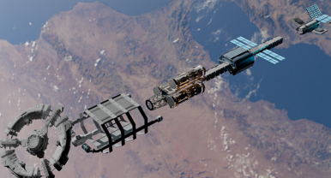
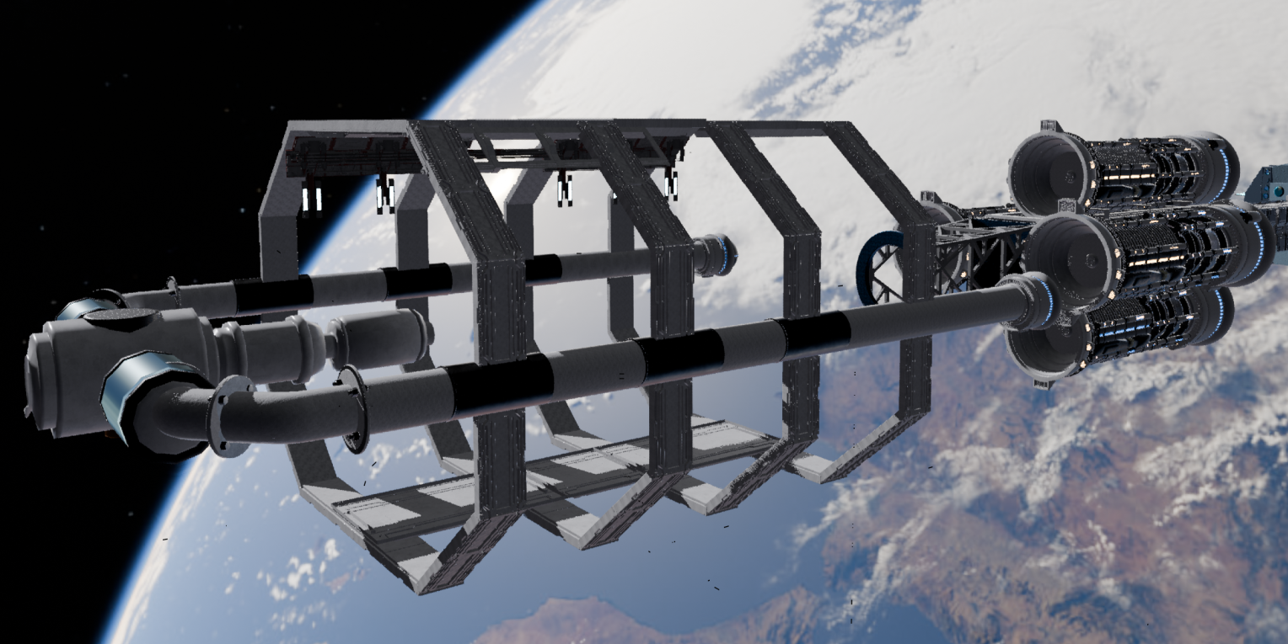
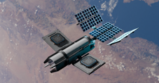
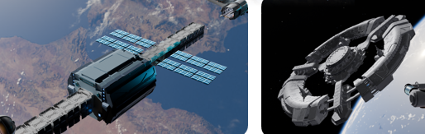
artistic direction
final renders
final pre-render
final look (low-poly) of the complete HELIOS spacestation
phase 3/2
phase 2
phase 1/3
docking and space infrastructure
high-volume and mass scale production
high-volume and mass scale production

Slide 10

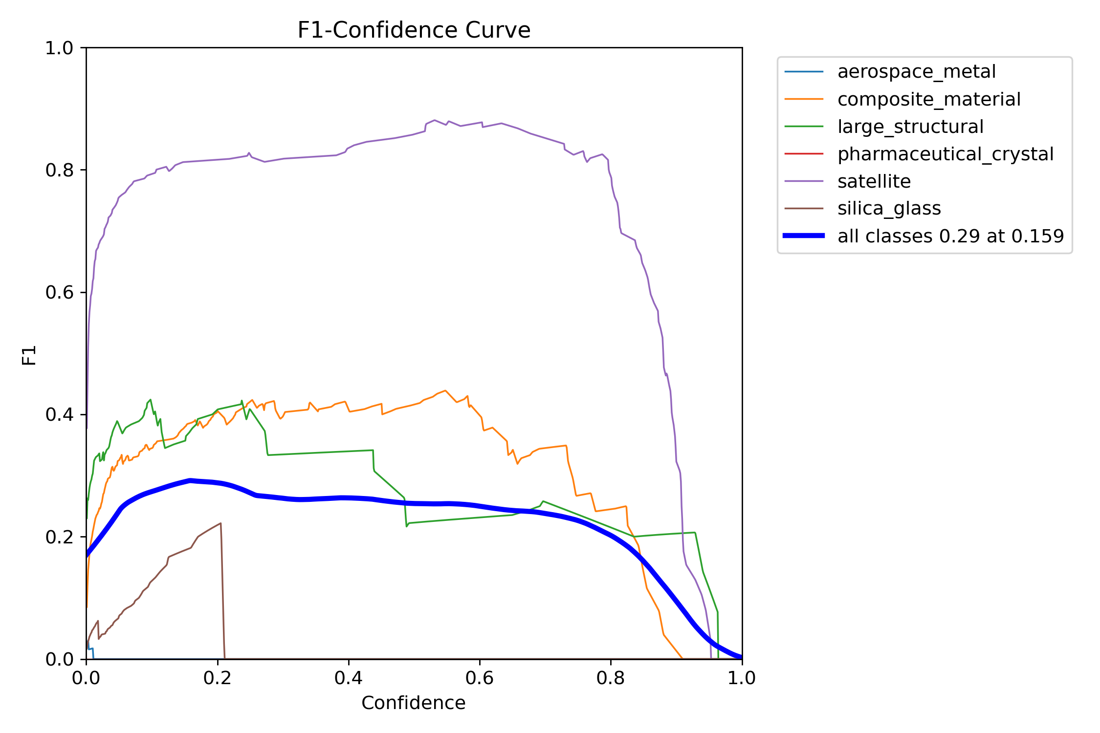
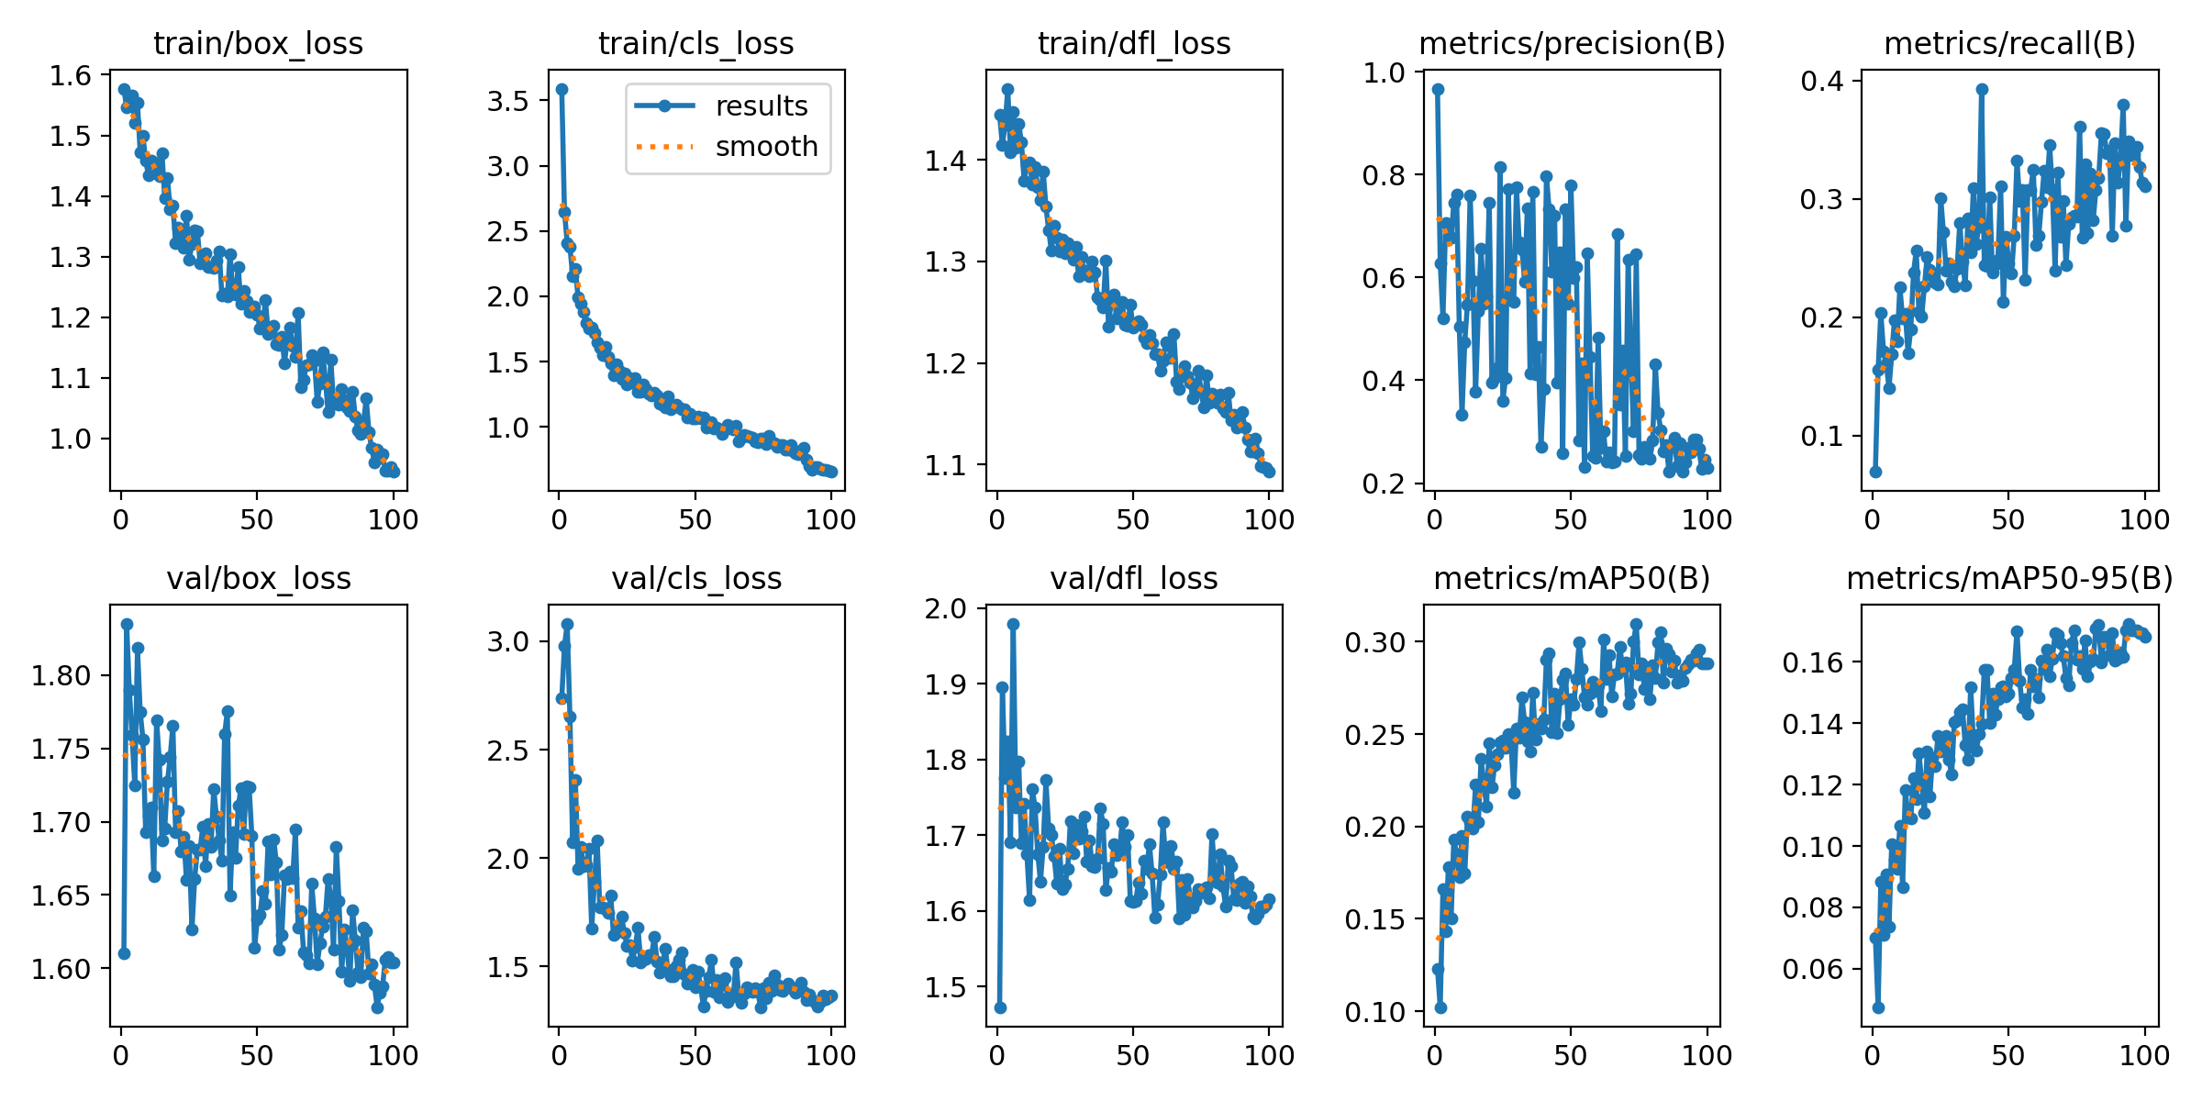
KAWAN 67
Autonomous S.A.C.C Drones
Identification Algorithm demonstration

Slide 11
KAWAN 67
Autonomous S.A.C.C Drones
Identification Algorithm results

